Slide 1
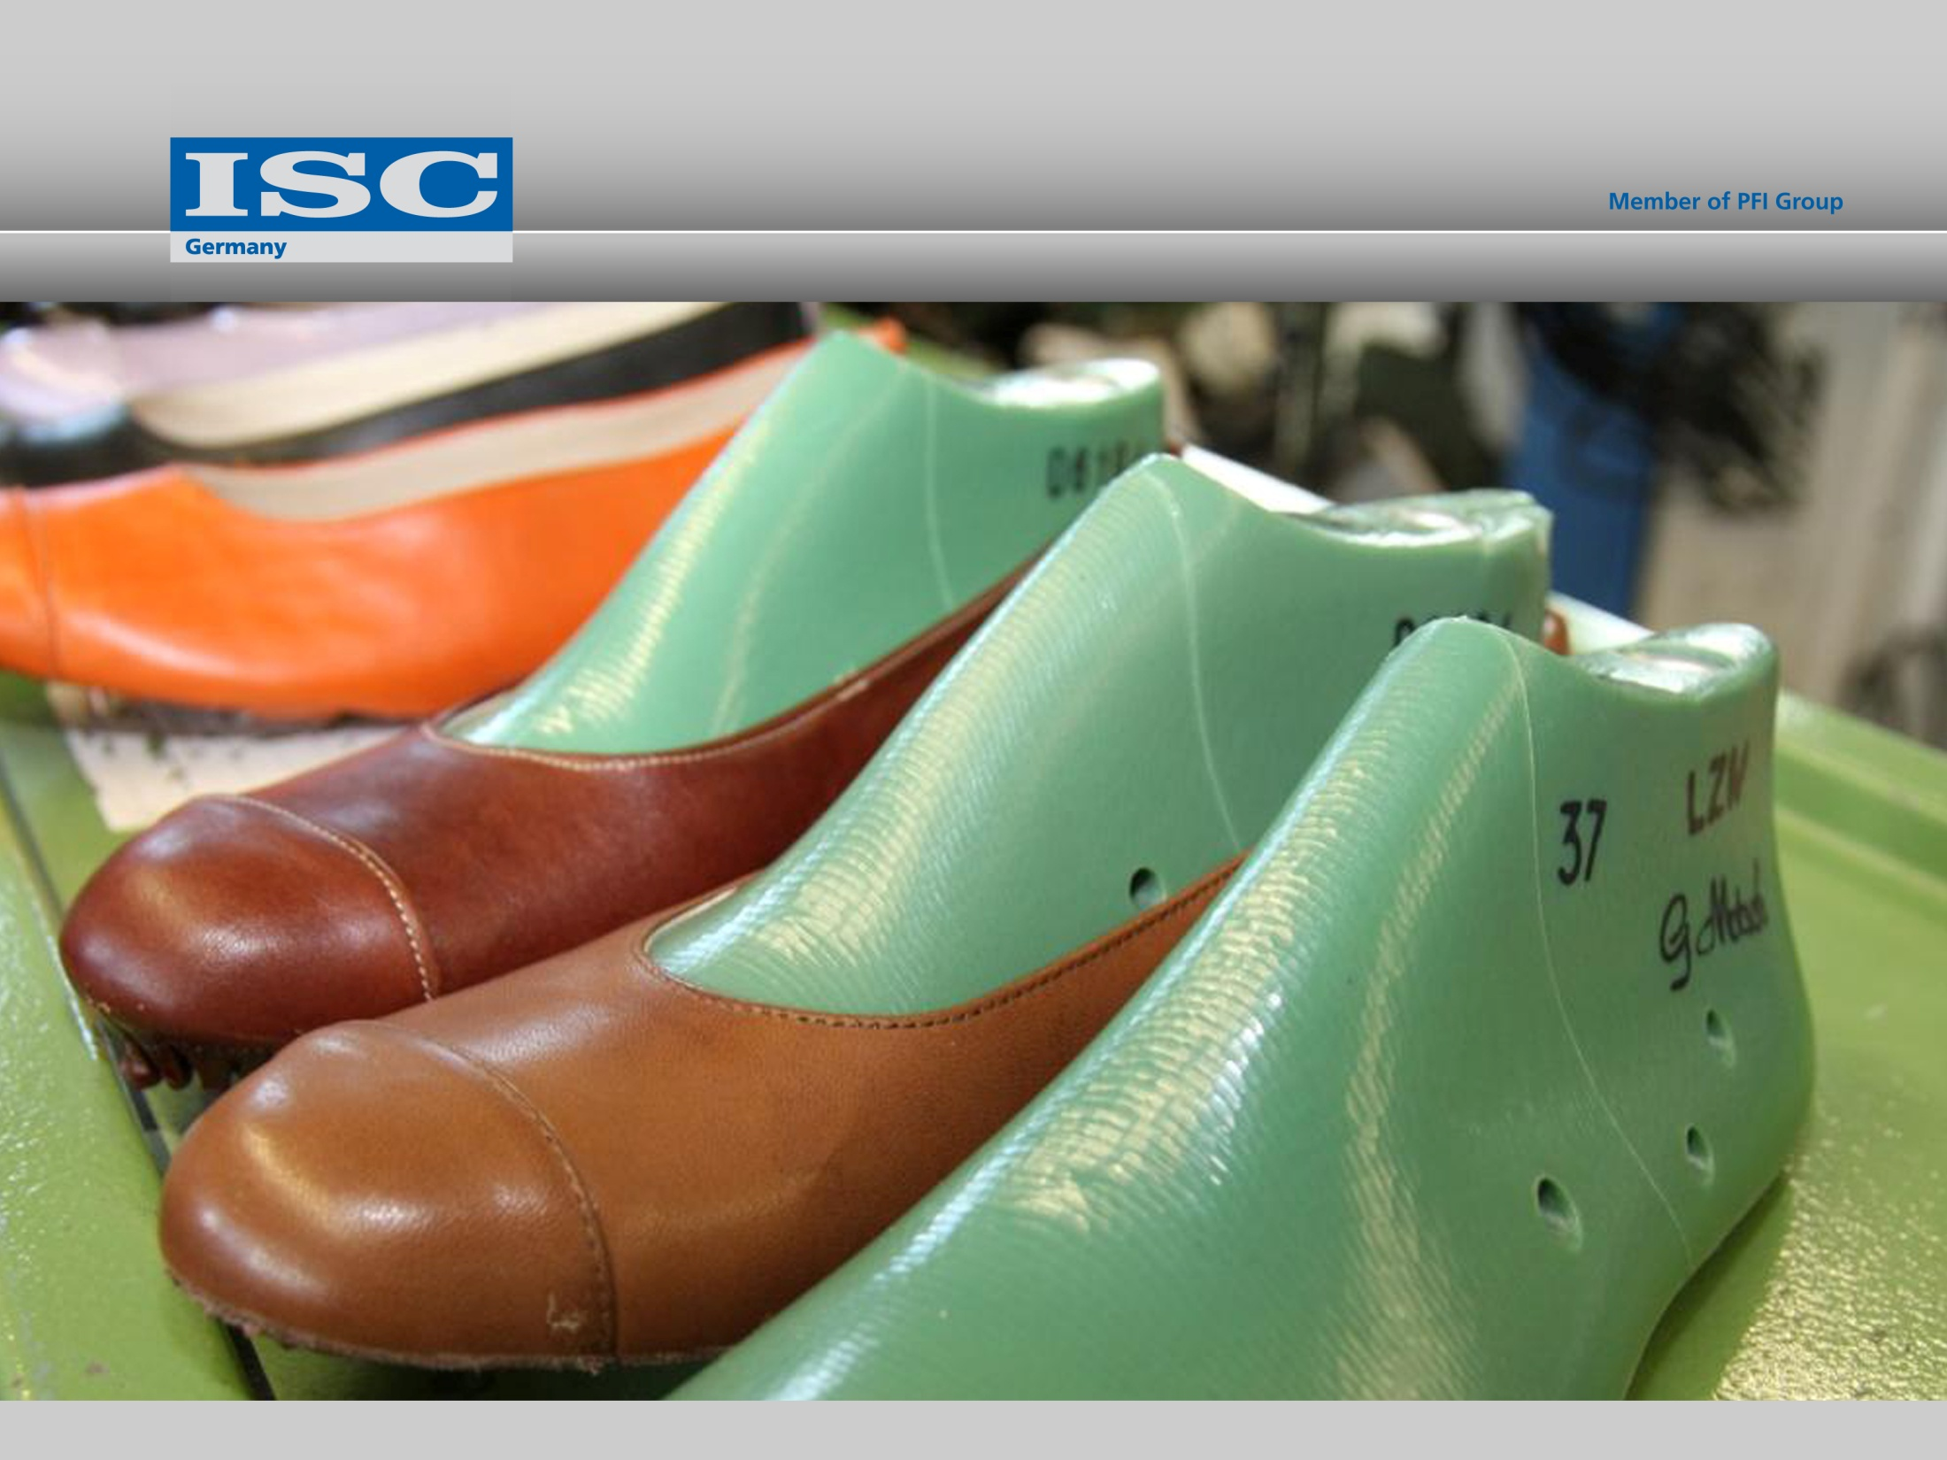
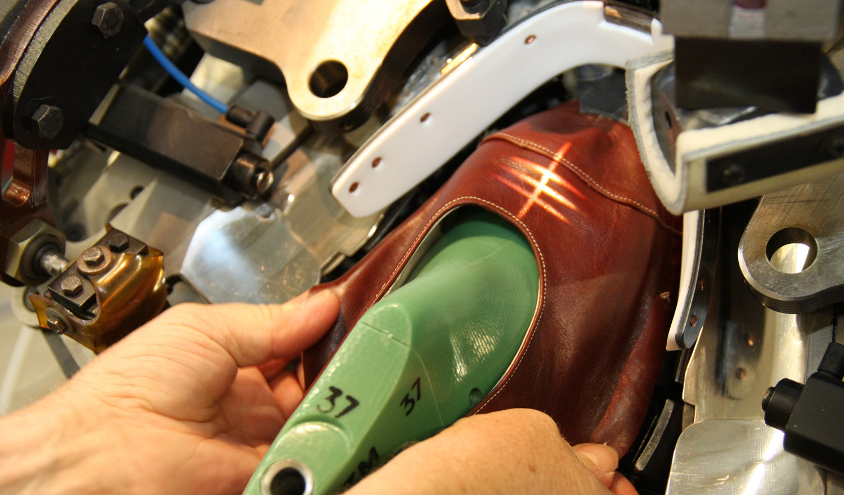
ISC: Experts in Leather and Footwear
Marie-Curie-Str. 20 | 66953 Pirmasens | Germany | Phone: +49 6331 145334 0 | Fax: +49 6331 145334 30 | E-Mail: info@isc-germany.com | Web: www.isc-germany.com

Slide 2
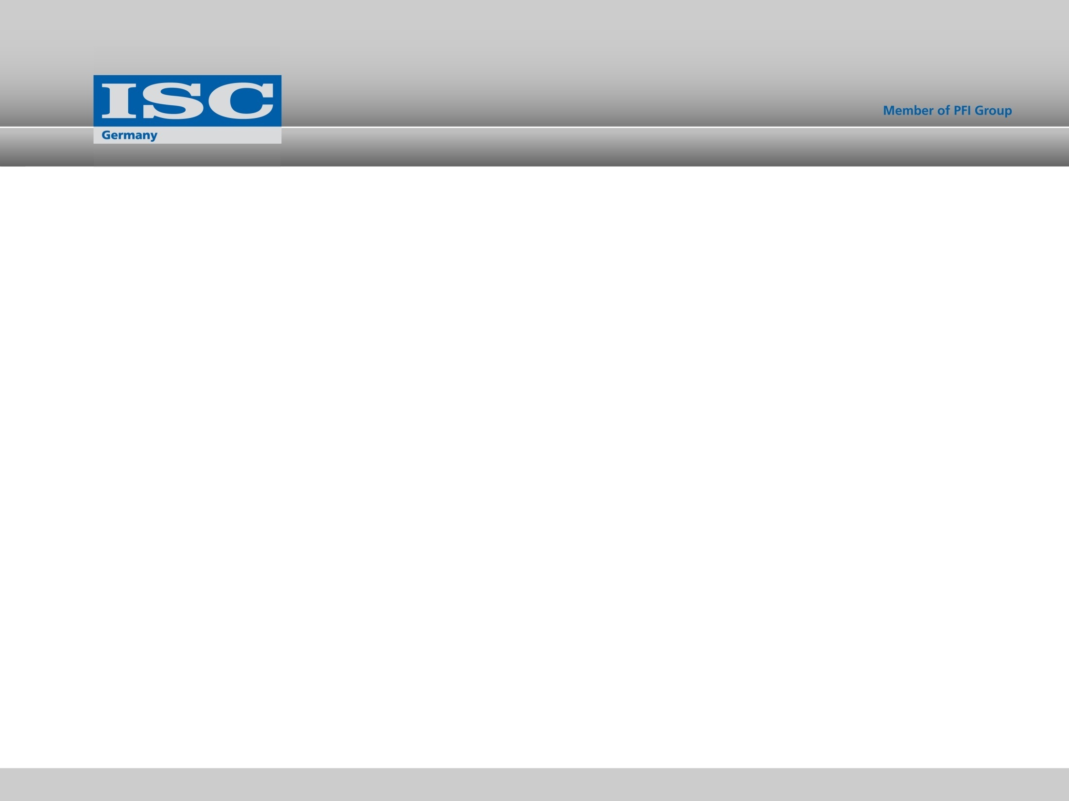
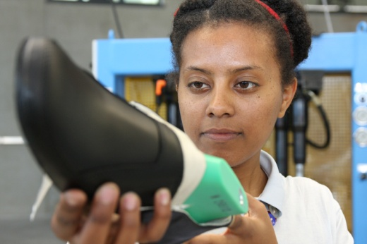
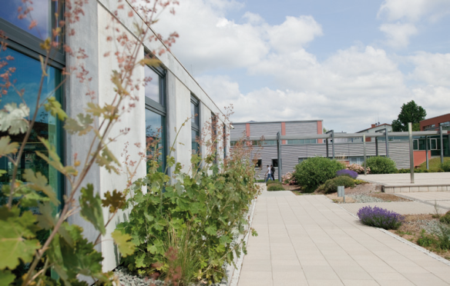

Contents
Who We Are
What We Do
ISC Trainings
R & D
Consulting
What to do in Pakistan
Our Partners
Marie-Curie-Str. 20 | 66953 Pirmasens | Germany | Phone: +49 6331 145334 0 | Fax: +49 6331 145334 30 | E-Mail: info@isc-germany.com | Web: www.isc-germany.com

Slide 3
Who We Are
The International Shoe Competence Center Pirmasens gGmbH, or ISC Germany for short, is a training and research center for the international leather and footwear industry, its suppliers, and for trade.
Marie-Curie-Str. 20 | 66953 Pirmasens | Germany | Phone: +49 6331 145334 0 | Fax: +49 6331 145334 30 | E-Mail: info@isc-germany.com | Web: www.isc-germany.com
Notes:
The International Shoe Competence Center Pirmasens gGmbH, or ISC Germany for short, is a training and research center for the international leather and footwear industry and for trade.
We are based in Germany and operate on a global scale.

Slide 4
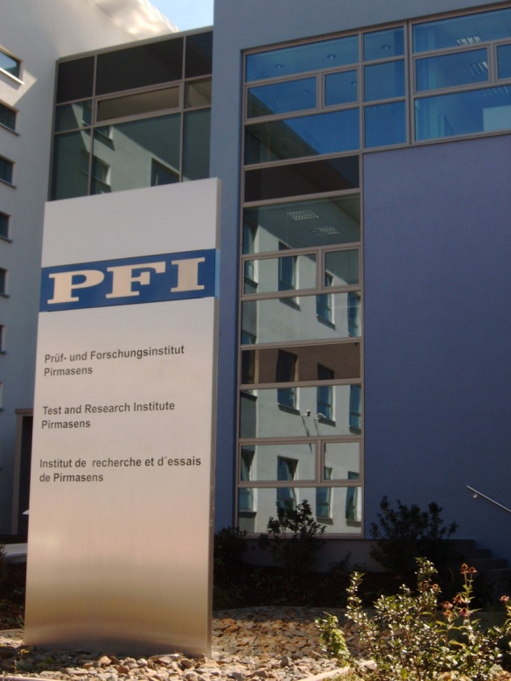








Who We Are
ISC Germany is an affiliate of the internationally renowned Test and Research Institute Pirmasens.
Since 1956
Marie-Curie-Str. 20 | 66953 Pirmasens | Germany | Phone: +49 6331 145334 0 | Fax: +49 6331 145334 30 | E-Mail: info@isc-germany.com | Web: www.isc-germany.com
Notes:
We are affiliated to the internationally known Test and Research Institute Pirmasens (Prüf- und Forschungs-institut, PFI), which has nearly 60 years of experience in the leather and footwear industry.
It is mainly known as a service provider for chemical and physical materials and product testing, but also as a research body.
More recently, PFI broadened its portfolio. Today, PFI also serves the plastics, adhesives, toy and PE industries: Since 2003 PFI has a microbiological and a biotechnological laboratory.
The PFI is also a certification body for products and processes (DIN EN ISO 9001, 14001 etc.).
PFI has numerous subsidiaries in Asia as well as in Turkey.

Slide 5
What We Do
You are looking for innovative solutions, for project partners or for training courses to reinforce the expertise of your staff?
Welcome at ISC Germany – what can we do for you?
Marie-Curie-Str. 20 | 66953 Pirmasens | Germany | Phone: +49 6331 145334 0 | Fax: +49 6331 145334 30 | E-Mail: info@isc-germany.com | Web: www.isc-germany.com
Notes:
We are based in Germany and operate on a global scale.
We can help you find innovative solutions, we can recrute project partners, or conceive made-to-measure training courses to reinforce the expertise of your staff.

Slide 6
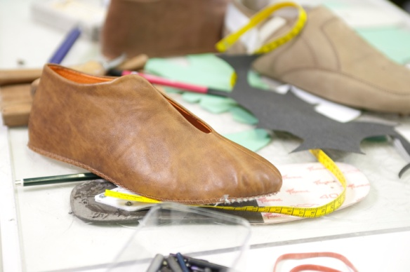
What We Do
We accompany you with a full-service offer along the complete value creation chain providing support in the following areas
  training, consultancy and research
  pattern development
  product and process engineering
  machines and materials
  quality management
  materials and product testing
  product certification
  marketing
Marie-Curie-Str. 20 | 66953 Pirmasens | Germany | Phone: +49 6331 145334 0 | Fax: +49 6331 145334 30 | E-Mail: info@isc-germany.com | Web: www.isc-germany.com
Notes:
Our offer is targeted to the international footwear and leather goods industries as well as for their machinery and materials’ suppliers, for the orthopaedic sector, for logistics companies as well as for trade.

Slide 7

ISC Trainings
The leather and shoe industry needs to be highly flexible and reactive as the markets are changing rapidly.
Product quality, the ability to innovate, and skilled labour are the key factors to success.
Marie-Curie-Str. 20 | 66953 Pirmasens | Germany | Phone: +49 6331 145334 0 | Fax: +49 6331 145334 30 | E-Mail: info@isc-germany.com | Web: www.isc-germany.com
Notes:
Our range of services comprises professional training, further education, R&D as well as consulting. We are specialised in conceiving tailor-made trainings focussing on the technical aspects of industrial shoe production aiming to increase quality and efficiency, and we impart product competence for purchasing and sales staff.
We work on a global scale and deploy our trainers wherever required by the customer. Our know-how covers the entire value chain:
Machines and materials
Product design
Development of prototypes and pilot series
- Production process
Quality assurance
- Material and product testing, and certification
Marketing and sales
Legal issues of the globalised sourcing and sales market

Slide 8
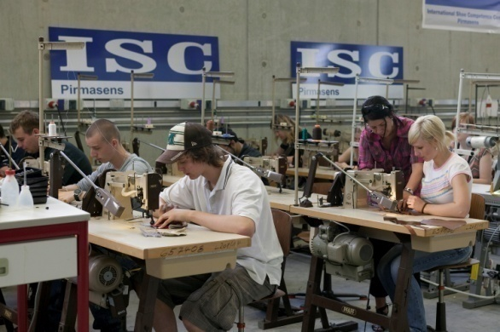
ISC Trainings
Our high-quality training and further education program places special emphasis on problem solving.
In our state-of-the-art training factory, ISC students can put their theoretical knowledge into practice.
This production line is ISC's nucleus: It serves for sample production and pilot runs, for working on developments, and for testing innovative production methods and technologies to establish their suitability for use in footwear production.
Marie-Curie-Str. 20 | 66953 Pirmasens | Germany | Phone: +49 6331 145334 0 | Fax: +49 6331 145334 30 | E-Mail: info@isc-germany.com | Web: www.isc-germany.com
Notes:
Our range of services comprises professional training, further education, R&D as well as consulting. We are specialised in conceiving tailor-made trainings focussing on the technical aspects of industrial shoe production aiming to increase quality and efficiency, and we impart product competence for purchasing and sales staff.
We work on a global scale and deploy our trainers wherever required by the customer. Our know-how covers the entire value chain:
Machines and materials
Product design
Development of prototypes and pilot series
- Production process
Quality assurance
- Material and product testing, and certification
Marketing and sales
Legal issues of the globalised sourcing and sales market

Slide 9
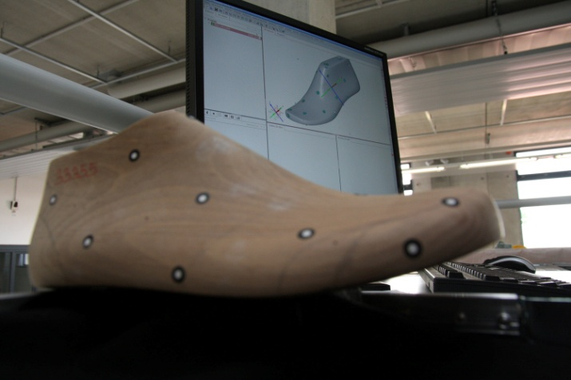
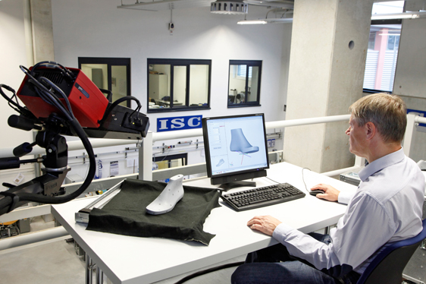
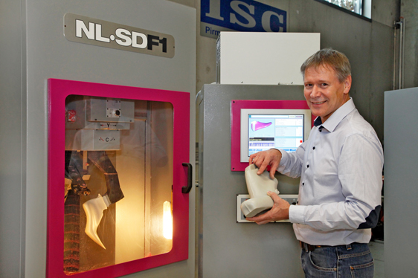
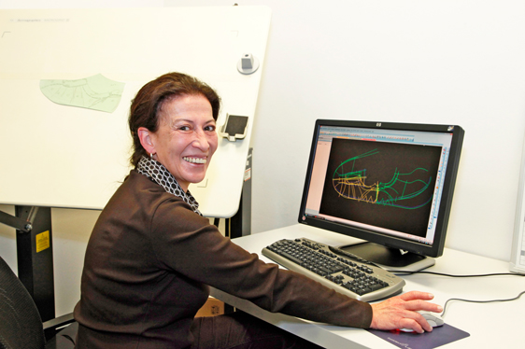
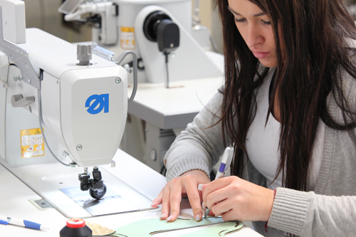
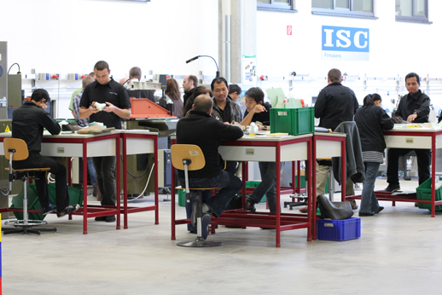
ISC Training Factory
Marie-Curie-Str. 20 | 66953 Pirmasens | Germany | Phone: +49 6331 145334 0 | Fax: +49 6331 145334 30 | E-Mail: info@isc-germany.com | Web: www.isc-germany.com
Notes:
Our range of services comprises professional training, further education, R&D as well as consulting. We are specialised in conceiving tailor-made trainings focussing on the technical aspects of industrial shoe production aiming to increase quality and efficiency, and we impart product competence for purchasing and sales staff.
We work on a global scale and deploy our trainers wherever required by the customer. Our know-how covers the entire value chain:
Machines and materials
Product design
Development of prototypes and pilot series
- Production process
Quality assurance
- Material and product testing, and certification
Marketing and sales
Legal issues of the globalised sourcing and sales market

Slide 10
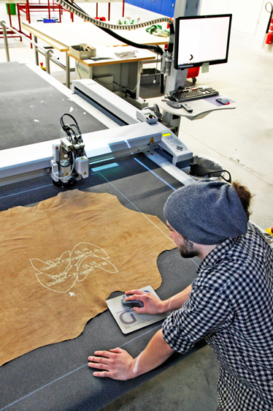
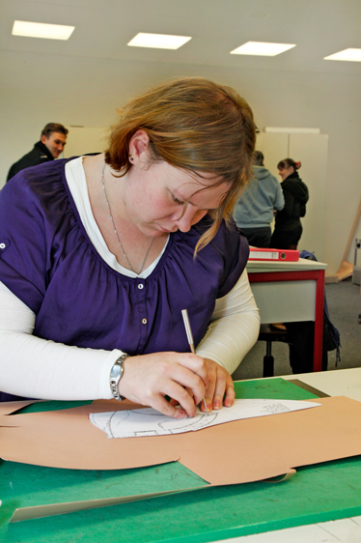
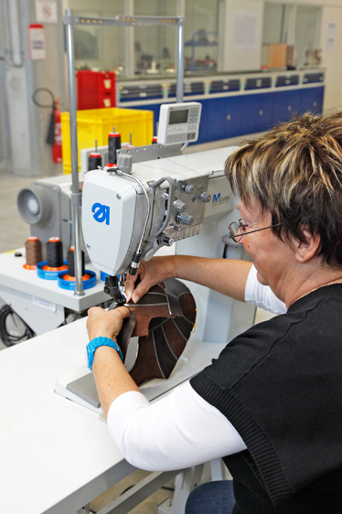
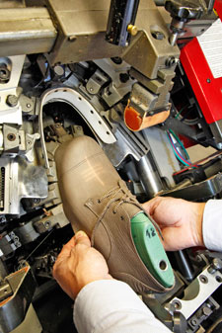
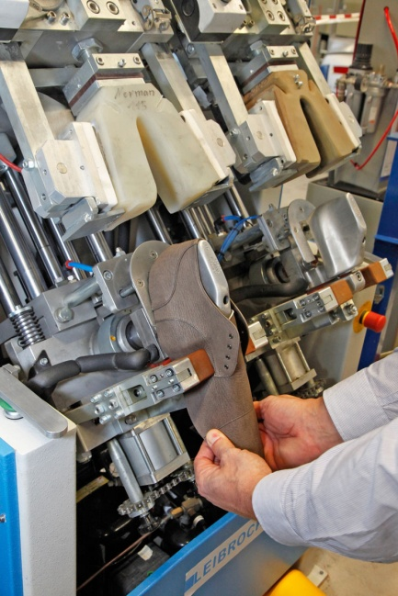
ISC Training Factory
Marie-Curie-Str. 20 | 66953 Pirmasens | Germany | Phone: +49 6331 145334 0 | Fax: +49 6331 145334 30 | E-Mail: info@isc-germany.com | Web: www.isc-germany.com
Notes:
Our range of services comprises professional training, further education, R&D as well as consulting. We are specialised in conceiving tailor-made trainings focussing on the technical aspects of industrial shoe production aiming to increase quality and efficiency, and we impart product competence for purchasing and sales staff.
We work on a global scale and deploy our trainers wherever required by the customer. Our know-how covers the entire value chain:
Machines and materials
Product design
Development of prototypes and pilot series
- Production process
Quality assurance
- Material and product testing, and certification
Marketing and sales
Legal issues of the globalised sourcing and sales market

Slide 11
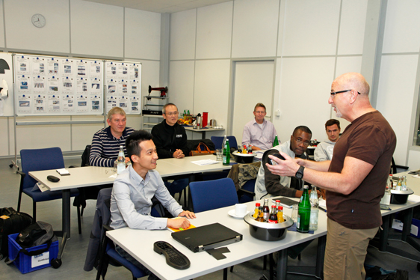
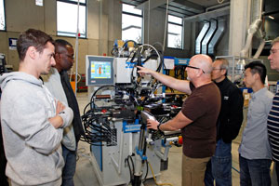


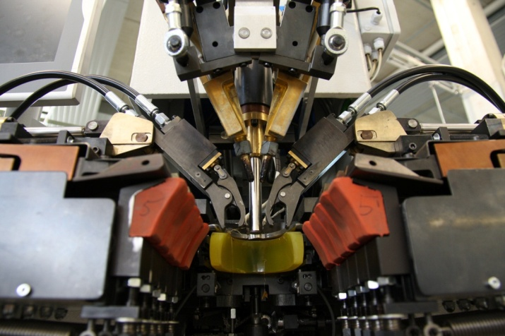
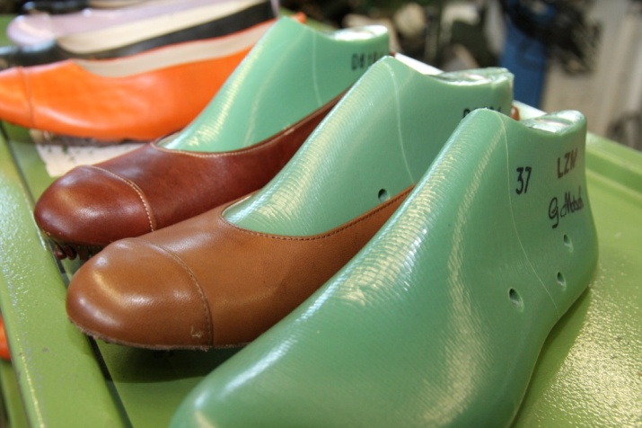
ISC Training Factory
Marie-Curie-Str. 20 | 66953 Pirmasens | Germany | Phone: +49 6331 145334 0 | Fax: +49 6331 145334 30 | E-Mail: info@isc-germany.com | Web: www.isc-germany.com
Notes:
Our range of services comprises professional training, further education, R&D as well as consulting. We are specialised in conceiving tailor-made trainings focussing on the technical aspects of industrial shoe production aiming to increase quality and efficiency, and we impart product competence for purchasing and sales staff.
We work on a global scale and deploy our trainers wherever required by the customer. Our know-how covers the entire value chain:
Machines and materials
Product design
Development of prototypes and pilot series
- Production process
Quality assurance
- Material and product testing, and certification
Marketing and sales
Legal issues of the globalised sourcing and sales market

Slide 12
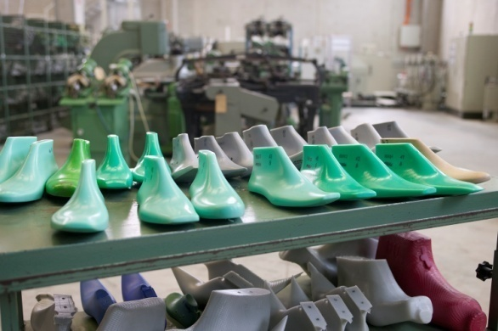
ISC Trainings
  We impart practice-oriented specialist knowledge in
  Last development / improving fit and comfort
  Footwear engineering / pattern development
  Materials
  New technologies
  Testing / Quality Management
  Process and production optimization
  Sustainability
  Marketing
Marie-Curie-Str. 20 | 66953 Pirmasens | Germany | Phone: +49 6331 145334 0 | Fax: +49 6331 145334 30 | E-Mail: info@isc-germany.com | Web: www.isc-germany.com

Slide 13
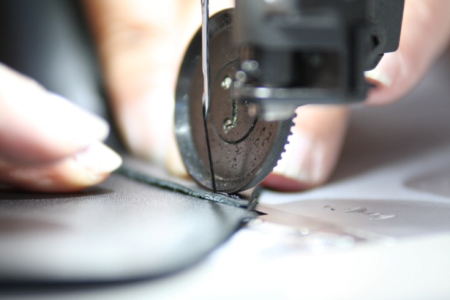
ISC Trainings
ISC conceives made-to-measure trainings tailored to the individual requirements of each customer.
The training courses can be held either at ISC in Pirmasens or at our clients’ premises no matter where on the globe.
Marie-Curie-Str. 20 | 66953 Pirmasens | Germany | Phone: +49 6331 145334 0 | Fax: +49 6331 145334 30 | E-Mail: info@isc-germany.com | Web: www.isc-germany.com
Notes:
We are specialised in designing customised practical training programmes for technicians, purchasers, or sales staff. Theses training courses are developed entirely in accord with clients' individual needs and demands.
In order to ensure that a training programme ideally matches a client's individual requirements, ISC German first prepares a highly detailed training concept which is coordinated point-by-point with the respective client.
ISC courses are taught both by highly qualified inhouse staff and by external lecturers who are all experienced specialists in various areas. Precisely this network of external tranings enables ISC to provide access to practical know-how from a wide range of areas.
The ISC training factory - our state-of-the-art production line equipped to produce prototypes and pilot runs of all makes - plays a key role in terms of practical instruction. The training courses can be held either at ISC headquarters in Pirmasens or on the premises of clients all over the world, in English or German as desired.

Slide 14
R&D at ISC
ISC Germany is engaged in publicly- and privately-funded research projects.
The fact that we are closely interlinked with the industry triggers numerous innovative ideas. We initiate research projects and collaborate with many different partners. The results are made available to the SMEs of the sector.
We also carry out contractual research and act as a development partner in externally initiated projects.
Marie-Curie-Str. 20 | 66953 Pirmasens | Germany | Phone: +49 6331 145334 0 | Fax: +49 6331 145334 30 | E-Mail: info@isc-germany.com | Web: www.isc-germany.com
Notes:
We are based in Germany and operate on a global scale.
ISC Germany is a subsidiary of the internationally acclaimed Test and Research Institute Pirmasens (PFI Pirmasens) and part of the PFI Group.

Slide 15

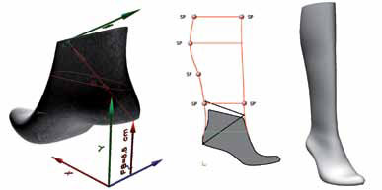
R&D at ISC
The technical aspects of shoe production are of great importance. We aim to develop methods and processes further and enhance them.
In our R&D activities, particular attention is devoted to open questions of fundamental research,research for sustainibility in shoe production as well as on biomechanics and orthopaedics.
Marie-Curie-Str. 20 | 66953 Pirmasens | Germany | Phone: +49 6331 145334 0 | Fax: +49 6331 145334 30 | E-Mail: info@isc-germany.com | Web: www.isc-germany.com
Notes:
We are based in Germany and operate on a global scale.
ISC Germany is a subsidiary of the internationally acclaimed Test and Research Institute Pirmasens (PFI Pirmasens) and part of the PFI Group.

Slide 16
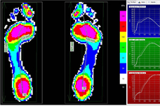
R&D at ISC
Whether a new shoe concept meets biomechanical criteria can now be approved at ISC directly on-site.
Range of services of the new biomechanical lab:
gait analyses (plantar pressure distribution measurement with force plate and/or in-shoe measuring system; video analysis)
seminars on anatomy and biomechanics
Marie-Curie-Str. 20 | 66953 Pirmasens | Germany | Phone: +49 6331 145334 0 | Fax: +49 6331 145334 30 | E-Mail: info@isc-germany.com | Web: www.isc-germany.com
Notes:
We are based in Germany and operate on a global scale.
ISC Germany is a subsidiary of the internationally acclaimed Test and Research Institute Pirmasens (PFI Pirmasens) and part of the PFI Group.

Slide 17
General technical problems in shoe companies
Missing technological knowledge in designing level
- material
- technology – What machines will be in proces?
- how to connect and position of parts to be able to smoothly pass through production
Technical design focused on the best acceptance in production
-selection of the components matching together – lasts, insoles, soles, counters, interlinings, tapes, …
-perfect production prescription – „V“ notches, skiving, needle and thread selection, position of outer and inner parts, thickness,
Correct lasts
Marie-Curie-Str. 20 | 66953 Pirmasens | Germany | Phone: +49 6331 145334 0 | Fax: +49 6331 145334 30 | E-Mail: info@isc-germany.com | Web: www.isc-germany.com
Notes:
We are based in Germany and operate on a global scale.
ISC Germany is a subsidiary of the internationally acclaimed Test and Research Institute Pirmasens (PFI Pirmasens) and part of the PFI Group.

Slide 18
General technical problems in shoe companies
Work with standards – knowledge about correct shapes of tools
-the way how to combine flexibility, quality and lower costs
Machine selection, optimal machine adjustments and preventive maintenance
Organization of working places
Organization of production flow – minimum work in progress (max.4 days from cutting to packing of the first „lot“)
Material, tools and components supply
Marie-Curie-Str. 20 | 66953 Pirmasens | Germany | Phone: +49 6331 145334 0 | Fax: +49 6331 145334 30 | E-Mail: info@isc-germany.com | Web: www.isc-germany.com
Notes:
We are based in Germany and operate on a global scale.
ISC Germany is a subsidiary of the internationally acclaimed Test and Research Institute Pirmasens (PFI Pirmasens) and part of the PFI Group.

Slide 19
General technical problems in shoe companies
Behaviour of technicians
- be in production area
- practically test the operations
- daily effort for improvement and documentation!!!
The way of decision making
- manager and leader
- selection of the aims to be reached
Marie-Curie-Str. 20 | 66953 Pirmasens | Germany | Phone: +49 6331 145334 0 | Fax: +49 6331 145334 30 | E-Mail: info@isc-germany.com | Web: www.isc-germany.com
Notes:
We are based in Germany and operate on a global scale.
ISC Germany is a subsidiary of the internationally acclaimed Test and Research Institute Pirmasens (PFI Pirmasens) and part of the PFI Group.

Slide 20
Advantages in Pakistan
Good quality of leather locally available
Stable rate for labour costs
China became to be expensive, India has not such a quality leathers
Long term reliable cooperations
Possibility to combine production for export and local market
Marie-Curie-Str. 20 | 66953 Pirmasens | Germany | Phone: +49 6331 145334 0 | Fax: +49 6331 145334 30 | E-Mail: info@isc-germany.com | Web: www.isc-germany.com
Notes:
We are based in Germany and operate on a global scale.
ISC Germany is a subsidiary of the internationally acclaimed Test and Research Institute Pirmasens (PFI Pirmasens) and part of the PFI Group.

Slide 21
Disdvantages in Pakistan
Not available machine and components
Not available technical support and service
Not existing modern education – partly acceptable education is only in design but the way of construction of cemented shoes should be changed according way trained at ISC = more precise, more comfortable, material saving
Absentism
Low flexibility – company focused on some types of products and markets
No international recognized laboratory
Marie-Curie-Str. 20 | 66953 Pirmasens | Germany | Phone: +49 6331 145334 0 | Fax: +49 6331 145334 30 | E-Mail: info@isc-germany.com | Web: www.isc-germany.com
Notes:
We are based in Germany and operate on a global scale.
ISC Germany is a subsidiary of the internationally acclaimed Test and Research Institute Pirmasens (PFI Pirmasens) and part of the PFI Group.

Slide 22
Job which was done
Practically proved the law – Relation among shapes of last, design and moolds mainly in making room(lasting)
The participants trained their ability to recognized deviations from the best process and understand the solutions
Group of participants and visited companies shown the team spirit and WILL to improve. Basic adjustments mainly making machines was recomended and also some tools which increase performance of machines.
Companies got the tips for short and long therm improvement but based only on short observations
The group of future trainers passed through starting theoretical and practical training which was proved in companies and some imrovements implemented
Marie-Curie-Str. 20 | 66953 Pirmasens | Germany | Phone: +49 6331 145334 0 | Fax: +49 6331 145334 30 | E-Mail: info@isc-germany.com | Web: www.isc-germany.com
Notes:
We are based in Germany and operate on a global scale.
ISC Germany is a subsidiary of the internationally acclaimed Test and Research Institute Pirmasens (PFI Pirmasens) and part of the PFI Group.

Slide 23
Main observations
Cutting departments –
- not existing quality cutting dies producer
- low quality cutting dies and not perfect process which shorten the durability of cutting blocks, machines and knives.
- low quality of skiving, not available basic consumption parts
Stitching departments –
- the biggest weakness starting from organization of stitching department
- not available multiskill workers
- cleanness of working places and selection of glue application tools and glues
- production flow is not legible, bottle neck should be seen immediately as well as not balanced line
Marie-Curie-Str. 20 | 66953 Pirmasens | Germany | Phone: +49 6331 145334 0 | Fax: +49 6331 145334 30 | E-Mail: info@isc-germany.com | Web: www.isc-germany.com
Notes:
We are based in Germany and operate on a global scale.
ISC Germany is a subsidiary of the internationally acclaimed Test and Research Institute Pirmasens (PFI Pirmasens) and part of the PFI Group.

Slide 24
Main observations
- preventive maintenance
Making rooms
- not correct decisions done in machines adjustments
- not awailable basic variety of hand and consumption tools (brushes, roughing tools, glue pots, moulds)
- missing preventive maintenance, adjustmend of smooth movements, cleaning
- frequent mistakes in connections of sole presses to compressed air = wrong timing
- big wrincles in front part
- damaged leather at roughing
- big quantity of glue on lasting margin and sole
- missing professional hor air blowers which can iron some wrincles
- missing variety of raughing tools - sand papers and brushes
- 3-5sizes of flages hoding roughing brushes recomended
Marie-Curie-Str. 20 | 66953 Pirmasens | Germany | Phone: +49 6331 145334 0 | Fax: +49 6331 145334 30 | E-Mail: info@isc-germany.com | Web: www.isc-germany.com
Notes:
We are based in Germany and operate on a global scale.
ISC Germany is a subsidiary of the internationally acclaimed Test and Research Institute Pirmasens (PFI Pirmasens) and part of the PFI Group.

Slide 25
Tips and suggestions to be evaluated by local authorities
Basic physical laboratory on international level is needed to support export
Continue with the team trained at ISC and continuing with me at companies in fixing the deviations which was observed.
Prepare the list of long term and short therm aims and start to work on improvements. Select which will be the first which will be last. Create teams to solve problems or which should achive selected goals and support the teams. NO TEMPORARY SOLUTIONS. NOT MORE LIKE 5 AIMS AT THE SAME TIME.
Create „Advisory team“ for different professionals decisions = ISC and localy cooperating team
Marie-Curie-Str. 20 | 66953 Pirmasens | Germany | Phone: +49 6331 145334 0 | Fax: +49 6331 145334 30 | E-Mail: info@isc-germany.com | Web: www.isc-germany.com
Notes:
We are based in Germany and operate on a global scale.
ISC Germany is a subsidiary of the internationally acclaimed Test and Research Institute Pirmasens (PFI Pirmasens) and part of the PFI Group.

Slide 26
Tips and suggestions to be evaluated by local authorities
Decide about immediate support for Lasting course. Institude is not capable to fulfill expectations.
Reasons:
Majority of machines never did real work
Many machines covered with dust, rusty, not used
Not available lasts, insoles, toe puffs, counters and uppers matching the tools on making machines
Not available consumption parts and tools to train decisions which tool and why is the best for certain job – like wipers, teflon bands, moulds, brushes, different roughing tools etc.
Attitude – no interest to spent time with our team and learn more
Lack of know-how
Marie-Curie-Str. 20 | 66953 Pirmasens | Germany | Phone: +49 6331 145334 0 | Fax: +49 6331 145334 30 | E-Mail: info@isc-germany.com | Web: www.isc-germany.com
Notes:
We are based in Germany and operate on a global scale.
ISC Germany is a subsidiary of the internationally acclaimed Test and Research Institute Pirmasens (PFI Pirmasens) and part of the PFI Group.

Slide 27
Tips and suggestions to be evaluated by local authorities
Possible help:
Send the leading maintenance persons from industry to check the machines in case that persons from institute which were trained to operate the machines are not able to gurantee the proper run(paid support from producer might be needed)
Check the available tools, and find simple design on lasts which are matching the existing tools for practical training
Arrange enough quantity of lasts, uppers, insoles, counters, soles and tools needed for production
Each participant of „GIZ-ISC“ training can prepare 1-2 theoretical and practical lessons (in case that his company can invest his time)
Marie-Curie-Str. 20 | 66953 Pirmasens | Germany | Phone: +49 6331 145334 0 | Fax: +49 6331 145334 30 | E-Mail: info@isc-germany.com | Web: www.isc-germany.com
Notes:
We are based in Germany and operate on a global scale.
ISC Germany is a subsidiary of the internationally acclaimed Test and Research Institute Pirmasens (PFI Pirmasens) and part of the PFI Group.

Slide 28
Tips and suggestions to be evaluated by local authorities
Long term aim:
-New effective training unit should be in Lahore under professional supervision of selected members(or all members) of the trained group
Minimum 2 types of trainings should be done for the same group but split in 2 groups trained in different times.
Content the1st:
- Master rules for different designes in Cemented or very simillar technologies like strobel lasted and strobel for injection, california, hand or machine stitched sole, boots, oxford etc. with practicising professional decision which interlining, toe puff, counters, other reinforcements, needles, threads, technological steps, cost estimates, etc.
- lasting practical and theoretical deeper training on preprepared uppers
Marie-Curie-Str. 20 | 66953 Pirmasens | Germany | Phone: +49 6331 145334 0 | Fax: +49 6331 145334 30 | E-Mail: info@isc-germany.com | Web: www.isc-germany.com
Notes:
We are based in Germany and operate on a global scale.
ISC Germany is a subsidiary of the internationally acclaimed Test and Research Institute Pirmasens (PFI Pirmasens) and part of the PFI Group.

Slide 29
Tips and suggestions to be evaluated by local authorities
Content 2nd:
-Basic of comfort and biomechanic
-Own projects
-Best practise in shoe production
(Above mentioned trainings will be help for all participated companies and will bring training material for the future training centre)
Help to selected vendors to import wide variety of missing materials, tools and components
Regularly make the „round trips“ for sharing ideas and help with developments to the best practise
Help with individual long term development projects for individual companies
Support to the companies and technicians which will help to create training materials
Marie-Curie-Str. 20 | 66953 Pirmasens | Germany | Phone: +49 6331 145334 0 | Fax: +49 6331 145334 30 | E-Mail: info@isc-germany.com | Web: www.isc-germany.com
Notes:
We are based in Germany and operate on a global scale.
ISC Germany is a subsidiary of the internationally acclaimed Test and Research Institute Pirmasens (PFI Pirmasens) and part of the PFI Group.

Slide 30
























ISC Partners
Numerous partners have joined us! Become part of the network!
Marie-Curie-Str. 20 | 66953 Pirmasens | Germany | Phone: +49 6331 145334 0 | Fax: +49 6331 145334 30 | E-Mail: info@isc-germany.com | Web: www.isc-germany.com
Notes:
We are based in Germany and operate on a global scale.
ISC Germany is a subsidiary of the internationally acclaimed Test and Research Institute Pirmasens (PFI Pirmasens) and part of the PFI Group.

Slide 31
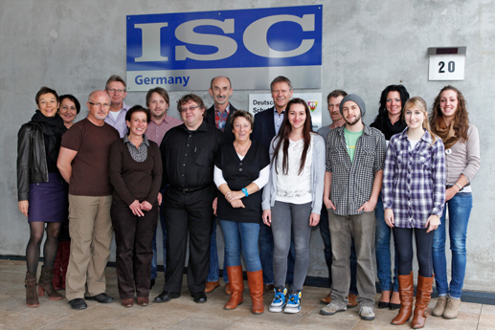
ISC Germany
Thank you for your attention!
Marie-Curie-Str. 20 | 66953 Pirmasens | Germany | Tel.: +49 6331 145334 0 | Fax: +49 6331 145334 30 | E-Mail: info@isc-pirmasens.de | Web: www.isc-pirmasens.de
Notes:
We are based in Germany and operate on a global scale.
ISC Germany is a subsidiary of the internationally acclaimed Test and Research Institute Pirmasens (PFI Pirmasens) and part of the PFI Group.

